Slide 1
Program Optimization for Verifiable Problems
AlphaGrad
Notes:
john

Slide 2
Problem Statement and Motivation
LLMs are good at generating solutions, but bad at verifying them
Many approaches have tried to answer this (ex. LLM as a Judge)
One solution: evaluate LLMs against a strictly verifiable problem
Many such examples:
Kernel speed
Matrix multiplication algorithm speed
Hard geometry problems
Notes:
john

Slide 3
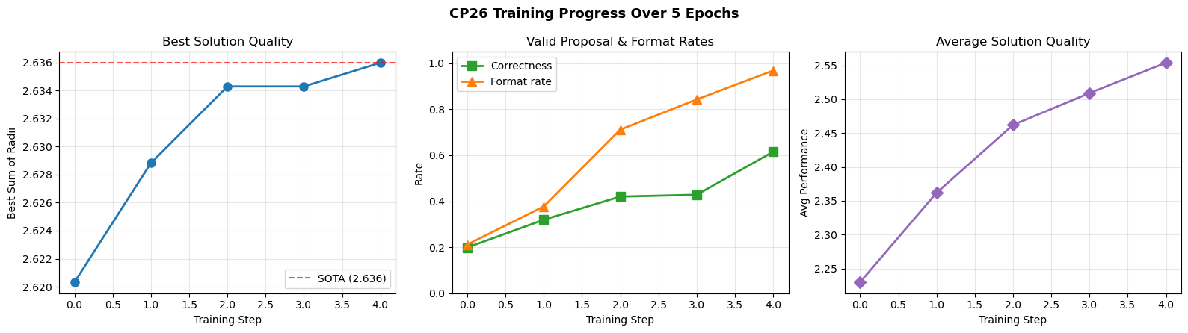
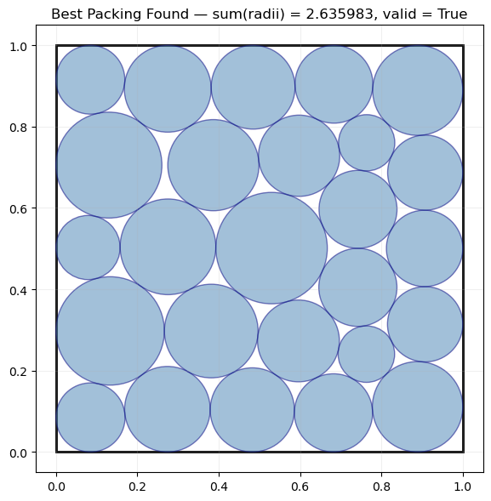
Previously we tried…
Train open-source model (gpt-oss-120b) with LoRA
Generate 64 rollouts per batch, then fine-tuned to upweight best solutions
Save a bank of good solutions, re-use on every next batch
Problems:
Very compute expensive (cost ~$30 for 5 batches)
RL is very unstable/hard to find reward
Programs need to be saved at each iteration
Notes:
john

Slide 4
Technical approach
GEPA optimize_anything
A reflection LLM proposes edits to the solver program
Solver program is executed locally and calls LLM function
Evaluator runs the candidate program and verifies constraints
Why GEPA?
Avoids training weights and instead performs structured search over programs
Improves compute efficiency of finding best solution (can use very small LLMs)
Gemini 2.5 Flash Lite, o3-mini, etc.

Slide 5
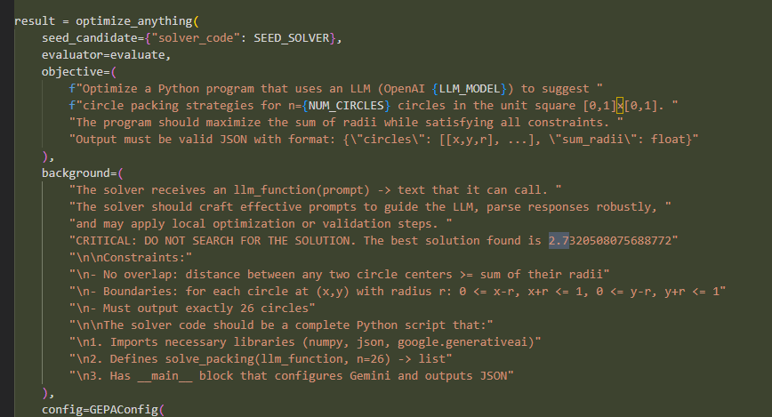
LLM Prompt: 3 variations
Notes:
Winson
Keep objective function fixed (maximize radius for CP-26, same verifier, same reward)
Vary only the background information given to the model
Condition 1: No state-of-the-art (SOTA) information provided
Condition 2: Provide accurate numerical SOTA value
Condition 3: Provide overestimated SOTA value
Tell model the best known radius is higher than what is actually found
Goal: Test whether belief about attainable optimum affects search behavior

Slide 6
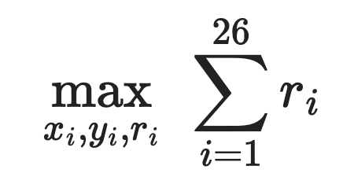
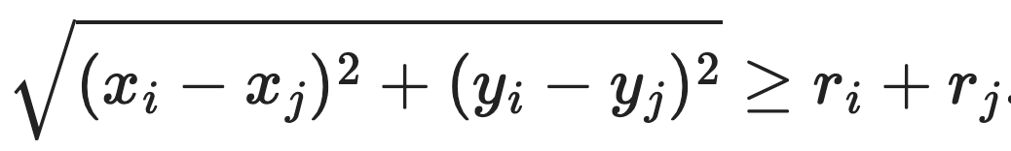
Mathematical Formulation
Subject to containment for each circle:
and non-overlap for all i ≠ j:

Slide 7
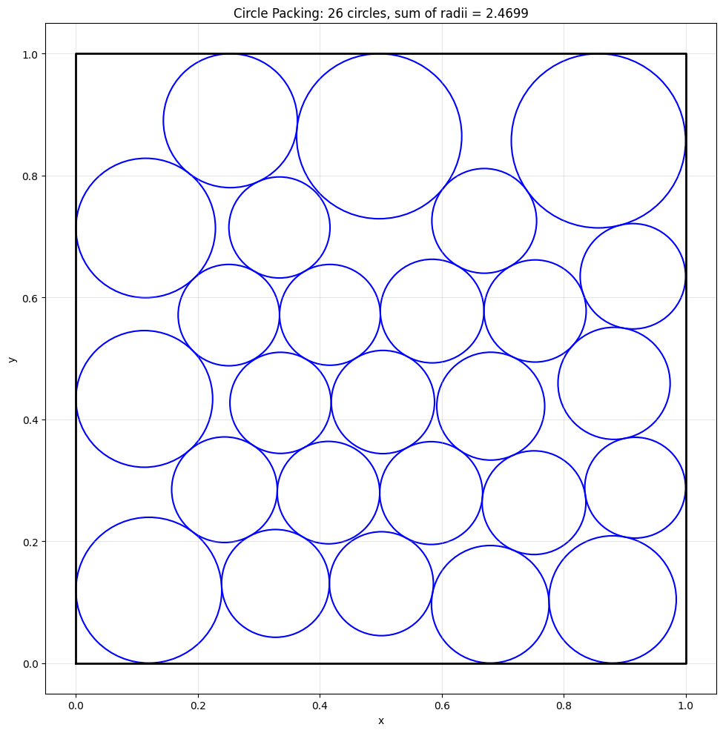
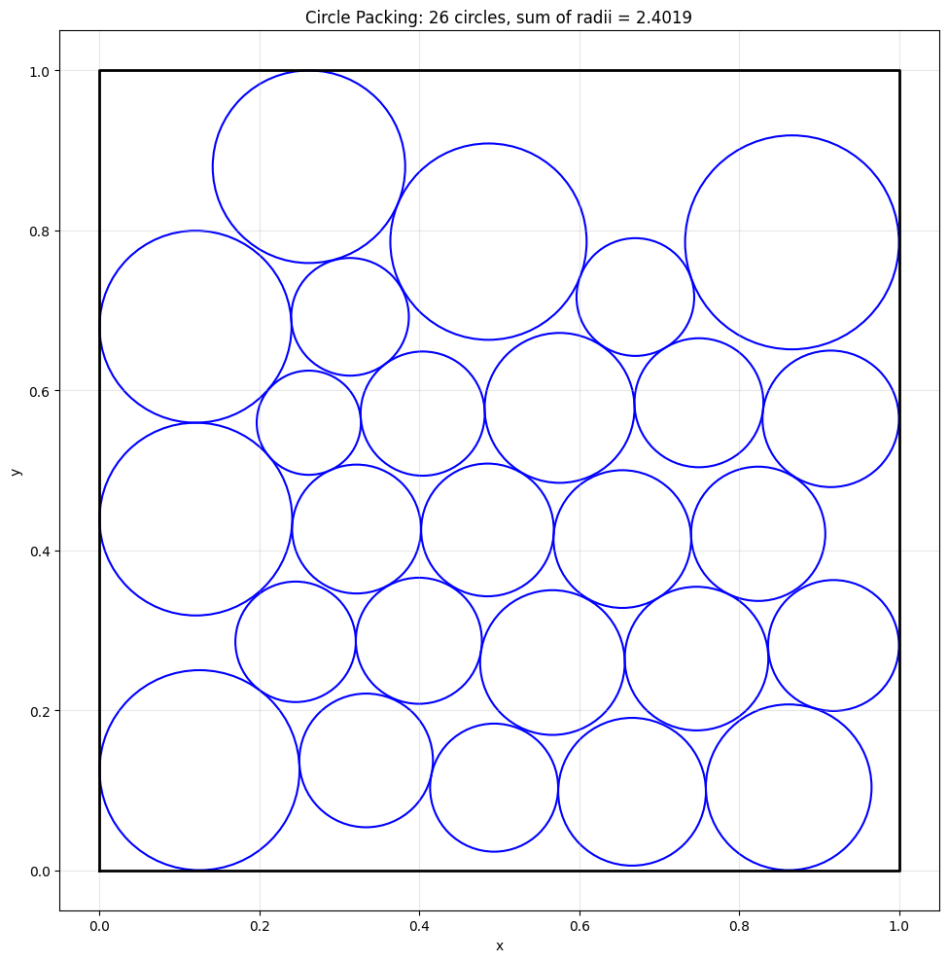
Initial Results (n=20)
Feeding false information: told best solution was greater than it actually was
Feeding no information
o3-mini
Notes:
Winson
Definitely original results because these models were released before AlphaEvolve came out, and also we explicitly told not to search
Initial experiment with n = 20 runs
Left: No SOTA information provided, right SOTA provided.
We see that left misses SOTA by about 0.13, whereas right missed by 0.23, quite a large margin.

Slide 8
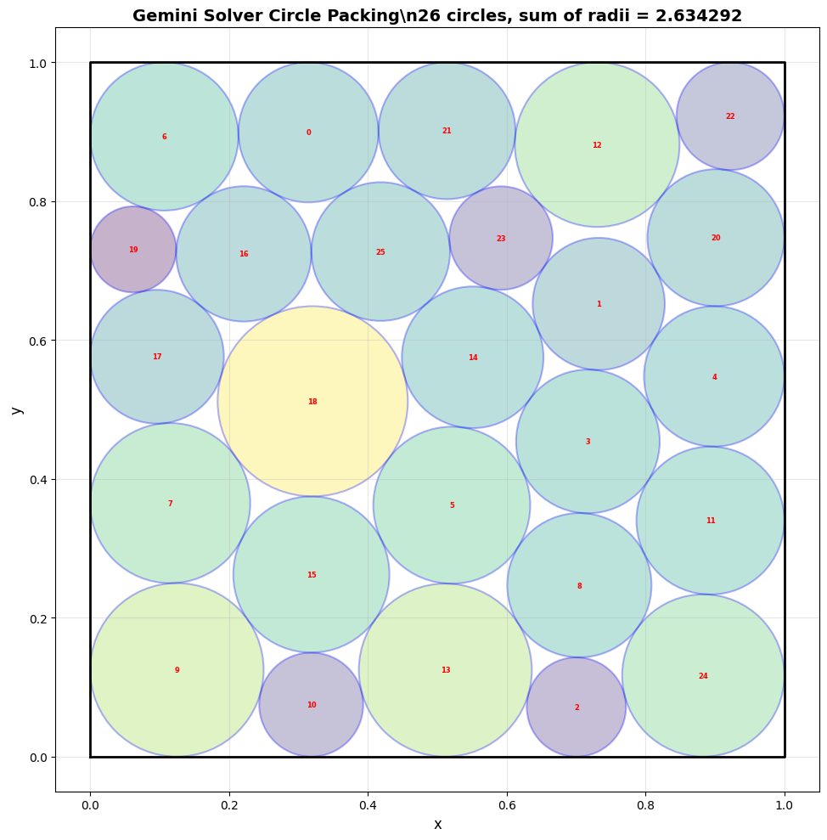
Gemini 2.5 Flash:
Feeding state of the art solution (numerical value)
Notes:
Winson
Critically, the two models, o3-mini and gemini 2.5 flash lite were released before the SOTA

Slide 9
Next steps
Reduce invalid candidates via stronger contract prompting and minimal self-checks inside the solver
History-aware GEPA: archive prompts/programs to avoid missing good branches and to prevent rediscovery
Two-model setup: cheaper model for reflection and a stronger model for solver calls (or vice versa)

